Slide 1
PYNOSE: A Test Smell Detector For Python
https://arxiv.org/pdf/2108.04639.pdf
Tongjie Wang - University of California, Irvine
Yaroslav Golubev - JetBrains Research
Oleg Smirnov - JetBrains Research
Jiawei Li - University of California, Irvine
Timofey Bryksin - JetBrains Research
Iftekhar Ahmed - University of California, Irvine

Slide 2
What are code smells?
- Smells are certain structures in the code that indicate violation of fundamental design principles.
- Subjective, and varies by language, developer, and development methodology.
- They are certainly not bugs, but increase the risk of bugs or failures in the future.

Slide 3
Unit testing
- The goal is to isolate each part of the program and show that the individual parts are correct.
- It provides a strict, written contract that the piece of code must satisfy mostly using validations.
- Safety net to refactor code with confidence.
- Tests are your documentation which talks about the importance in maintainability of software.

Slide 4
Statically typed languages
- It is very popular among development of backend systems.
- Main reason being compile time safety leading to less bugs and easier maintenance.
- Expressing business domains using types and building business logic around them.
- Majority of test smells research has been focused around these languages.

Slide 5
Python
- Dynamically typed language.
- Hugely popular and adapted in data science and machine learning projects.
- This paper is mostly focused on studying test smells in Python projects.

Slide 6
Goal of the paper
- Identifying test smells from well established open source python projects.
- Providing a tool (PYNOSE) for the test smell detection during development stages and also offline analysis.
- Also an empirical study of test smell pervasiveness by applying the PYNOSE tool on matured python projects.

Slide 7
Systematic mapping study
- Keyword search of "test smell" or "test smells" in digital libraries like ACM, IEEE and Scopus.
- Restrict to digital publications about software engineering methodologies, test smell detection and refactoring.
- There could be potential articles left out due to the above criteria and hence single iteration of backward snowballing is conducted on left out papers.
- Reliability of selected publications was manually evaluated.

Slide 8
Identifying test smells
- Focus was only on Unittest testing framework that is included in the Python Standard Library.
- Some of them are only valid for statically typed languages like Java or Scala.
- After the above process 17 smells were shortlisted.
- Shortlisted test smells are implemented in Python.

Slide 9
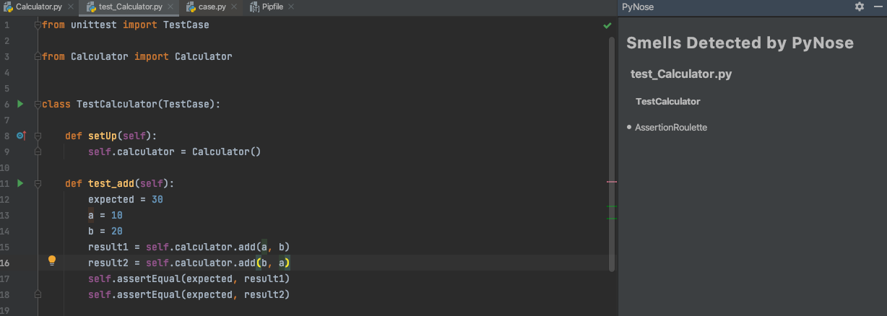
Assertion Roulette
A test case that contains more than one assertion statement without an explanation/message.

Slide 10
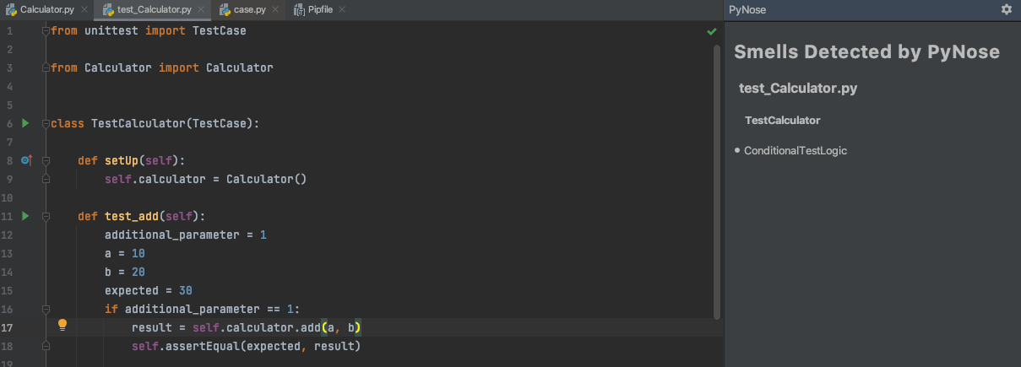
Conditional Test Logic
A test case that contains one or more control statements (i.e., if, for, while)

Slide 11
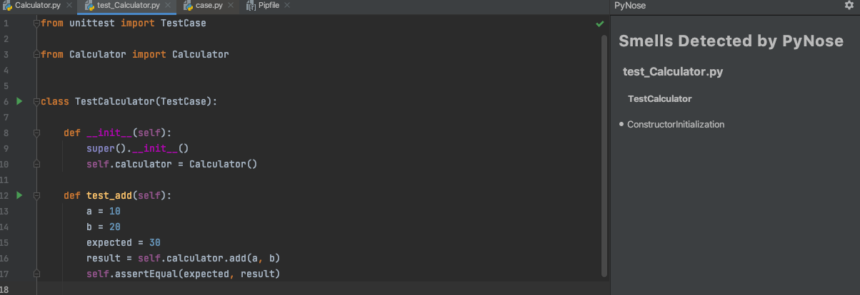
Constructor Initialization
A test case that contains more than one assertion statement without an explanation/message.

Slide 12
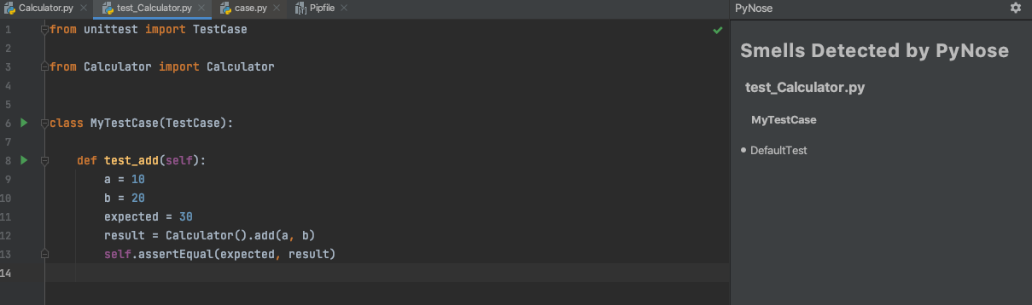
Default Test
A test suite is called MyTestCase which is a default name provided by IDE.

Slide 13
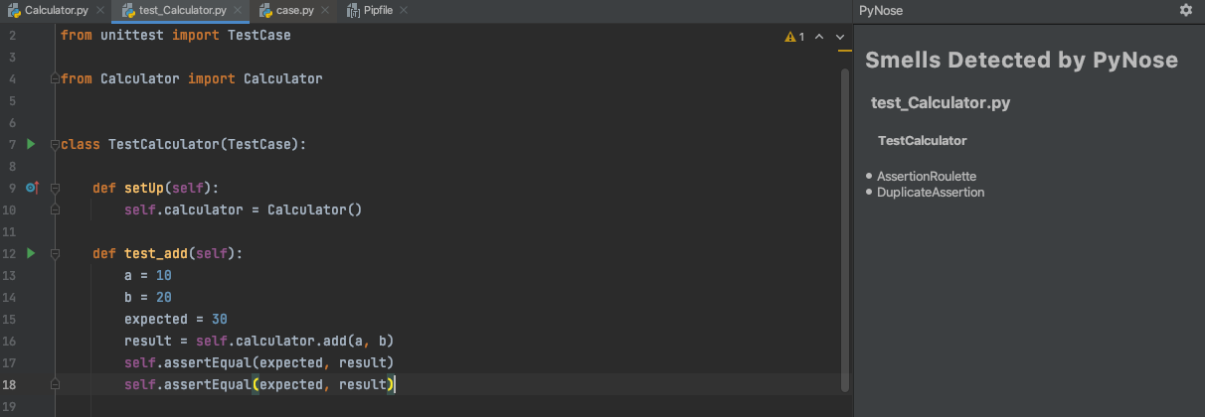
Duplicate Assert
A test case that contains more than one assertion statement with the same parameters.

Slide 14
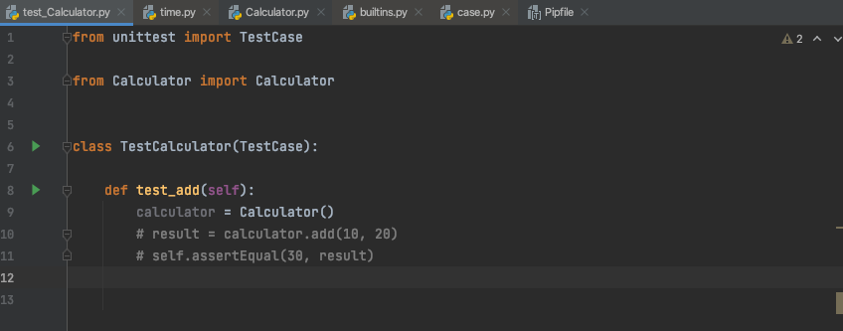
Empty Test
A test case where everything is commented out.

Slide 15
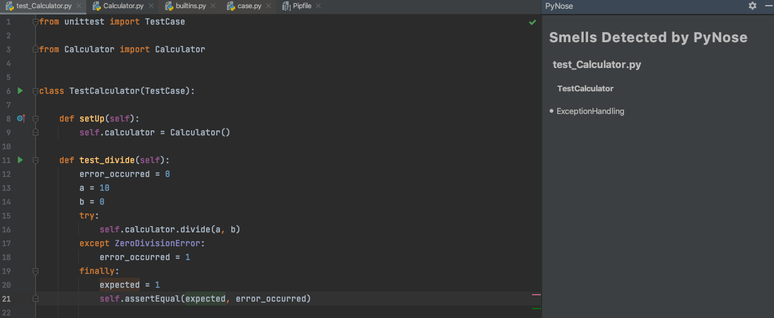
Exception Handling
A test case that contains either the try/except statement or the raise statement.

Slide 16
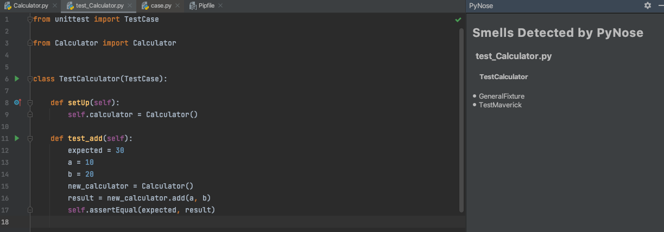
General Fixture
Not all fields instantiated within the setUp() method of a test suite are utilized by all test cases in this test suite.

Slide 17
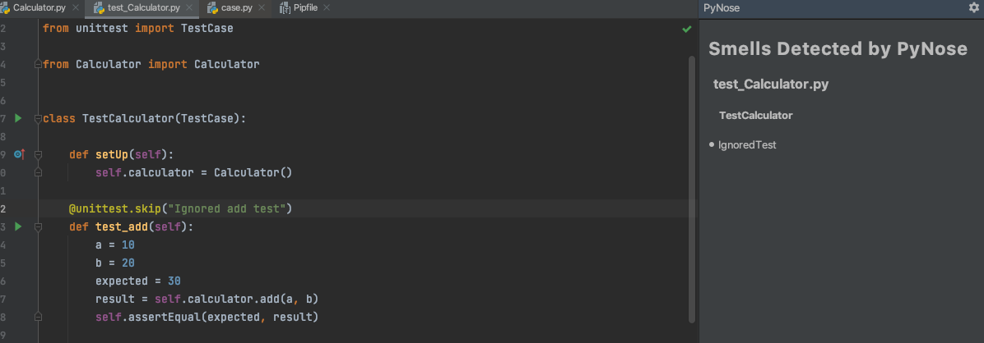
Ignored Test
A test case that contains the @unittest.skip decorator.

Slide 18
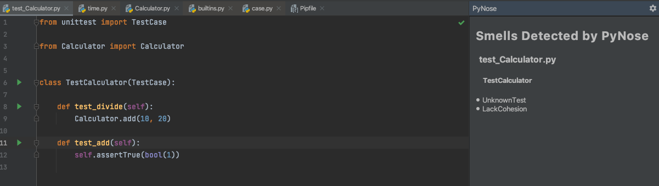
Lack of Cohesion of Test Cases
Test cases that are grouped together in one test suite but are not cohesive.

Slide 19
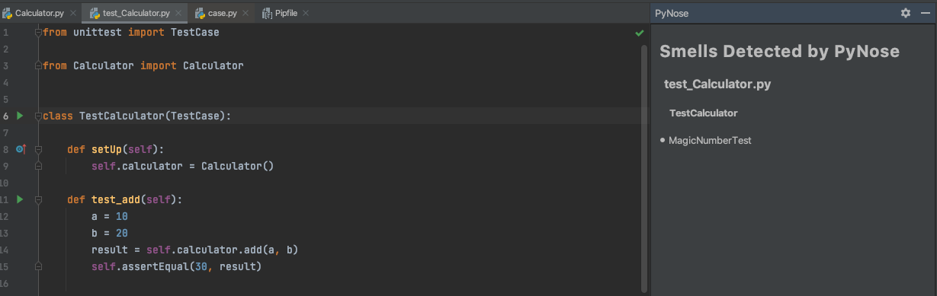
Magic Number Test
A test case that contains an assertion statement that contains a numeric literal as an argument.

Slide 20
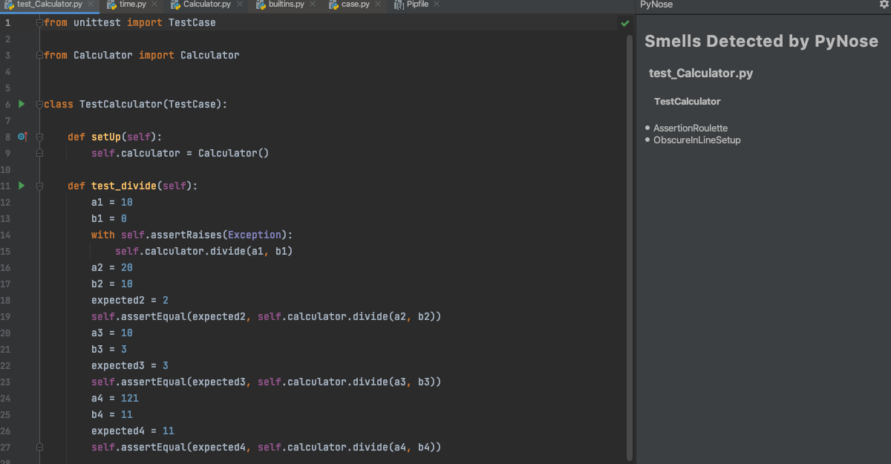
Obscure In-Line Setup
A test case that contains ten or more local variables declarations.

Slide 21
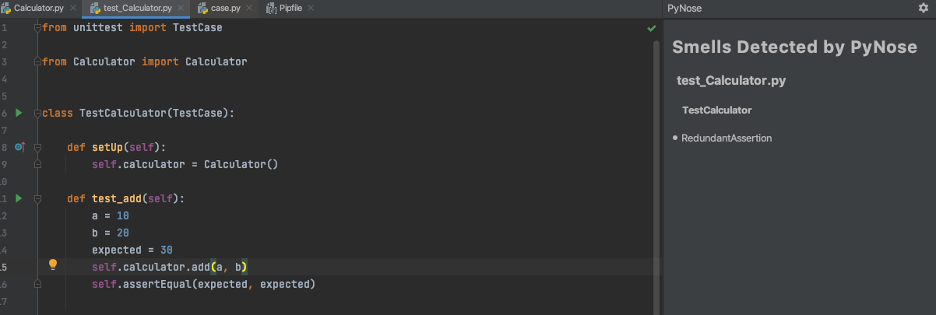
Redundant Assertion
A test case that contains an assertion statement in which the expected and actual parameters of equality are the same.

Slide 22
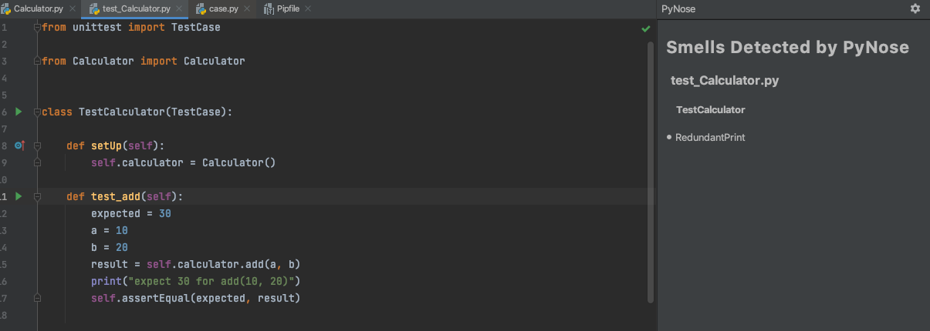
Redundant Print
A test case that invokes the print() function.

Slide 23
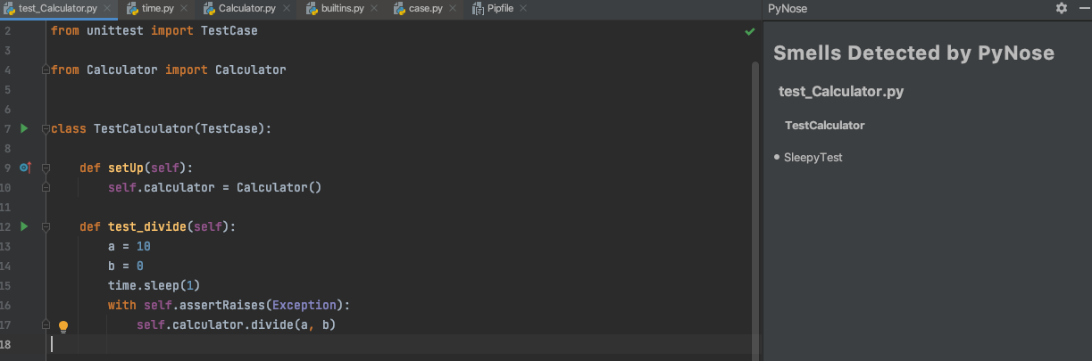
Sleepy Test
A test case that invokes the time.sleep() function with no comment.

Slide 24
Test Maverick
A test suite contains at least one test case that does not use a single field from the SetUp() method.

Slide 25
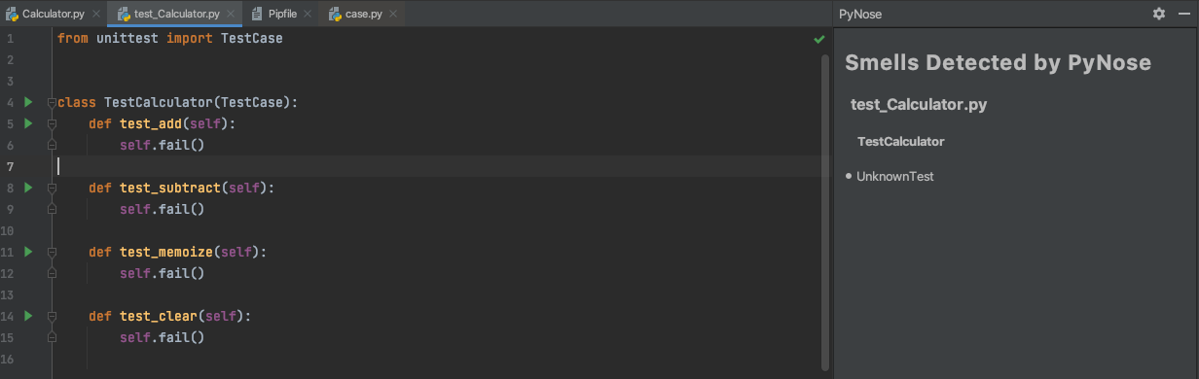
Unknown Test
A test case does not contain a single assertion statement.

Slide 26
Identifying Python specific test smells
- Selected a primary dataset of mature open source projects with atleast 1000 commits, 10 contributors.
- Find all test files having "test" in its name. which is the unittest naming convention.
- Find patterns in the histories of the collected projects where changes made to test files that might be considered as fixing the test or fixing the smell.
- A Tool developed to mine change patterns in commit history is named PythonChangeMiner.

Slide 27
PythonChangeMiner
- It builds a program dependence graph with representing the code by showing its data dependencies and control dependencies.
- It builds a change graph for the fragment of code changes using the versions of code before and after the target change.
- It mines such change graphs from git repositories by traversing their commit history, and discover patterns in these change graphs.
- The pattern is defined by two thresholds: minimum number of graph nodes in the pattern, and minimum number of repetitions of the pattern in the corpus.

Slide 28
Suboptimal Assert
- After identifying common patterns more than 3 different projects, majority of patterns related to assertion functionality changes which are related to test smells.
1. Assertion changes that alter the logic. Ex. Changing from assertEqual to assertRegex. 2. Assertion changes that do not alter the logic and use more appropriate functions. Ex. assertTrue(X in Y) to assertIn(X, Y) or assertEqual(X, False) is changed to assertFalse(X). 3. Assertion changes that do not alter the logic and use less appropriate functions. Ex. Moving from a more specific assertIsNotNone(X) to a more general assertNotEqual(X, None) which leads to test smell.

Slide 29
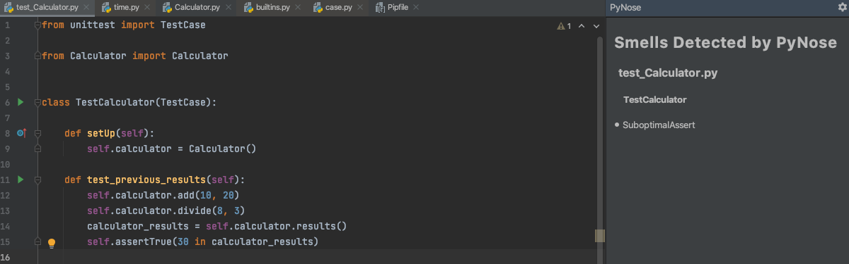
Suboptimal Assert
A test case that contains at least one of the suboptimal asserts.

Slide 30
PYNOSE
- PYNOSE is implemented as a plugin for PyCharm IDE.
- This tool identifies 18 test smells in actual Python code. It parses .py files to PSIFile objects and detects smells.
- Supports GUI mode in active code development or CLI mode for offline analysis.
- It can report the results as JSON files for further evaluation.

Slide 31
Evaluation of PyNose results
- Manually selected 8 projects that did not make it to primary dataset and marked as validation set.
- Then the validation are run against PYNOSE and results are compared against the manual set.
- The results like precision, recall and F1 values are compared with manual and looks very close. (94.0%, 95.8%, 94.9%)
- Also the overall results are compared with TSDetect (similar tool for Java). (96.0%, 97.1%, 96.5%)

Slide 32
Empirical study on test smell prevalence
- Apart from primary dataset, secondary dataset of projects (less commits) was selected for identifying test smells.
- The purpose of the secondary dataset is to make sure that the reported results are unbiased.
- Test smells distribution are similar when compared between primary dataset and secondary dataset.
- For better analysis, co-occurence of test smells are identified across test suites. The test smell distribution percentage demonstrates that test smells have relationship with one another.

Slide 33
Future work
- Supporting more PYTHON test smells.
- Conducting a more thorough comparison of PYNOSE to other tools. For example, to TSDETECT that works with Java/Scala.
- It would be of great interest to see how test smells correlate with test coverage.

Slide 34

Thanks!

